Slide 1
DITAP
Types of research and
The art of interviewing

Slide 2
We are going to cover….
Types of Research: Qual vs Quant
Qual Research: The life force of the design process
ACTIVITY!
Interviewing Do’s and Don’ts
ACTIVITY!
Notes:
End users take a slice of the information layer likely every day when they look up information and images, or complete forms online or on a mobile device.

Slide 3
Types of Research: Qual vs Quant

Slide 4
Quantitative vs Qualitative
Quantitative Research
Helps us understand what is happening or how many.
Notes:
End users take a slice of the information layer likely every day when they look up information and images, or complete forms online or on a mobile device.

Slide 5
Quantitative vs Qualitative
Quantitative Research
Helps us understand what is happening or how many.
Qualitative Research
Helps us understand why people do the things they do.
Notes:
End users take a slice of the information layer likely every day when they look up information and images, or complete forms online or on a mobile device.

Slide 6
Quantitative vs Qualitative
Quantitative Research
The reason to do this is to get statistical likelihoods and significance.
Notes:
End users take a slice of the information layer likely every day when they look up information and images, or complete forms online or on a mobile device.

Slide 7
Quantitative vs Qualitative
Quantitative Research
“How many people typically receive a Green Card each year?
“How many of those people are Hispanic women?”
Notes:
End users take a slice of the information layer likely every day when they look up information and images, or complete forms online or on a mobile device.

Slide 8
Quantitative vs Qualitative
Quantitative Research
“How many people typically receive a Green Card each year?
“How many of those people are Hispanic women?”
Tools & Methods
Surveys/Polls
Analysis of existing data and statistics
Analytics software (captures and tracks information)
Notes:
End users take a slice of the information layer likely every day when they look up information and images, or complete forms online or on a mobile device.

Slide 9
Business Problems
Qualitative Research
The reason to do this is to get an understanding of the experiences, perceptions, behaviors, attitudes and the meanings attached to them.
Notes:
End users take a slice of the information layer likely every day when they look up information and images, or complete forms online or on a mobile device.

Slide 10
Business Problems
Qualitative Research
The reason to do this is to get an understanding of the experiences, perceptions, behaviors, attitudes and the meanings attached to them.
Tools & Methods (a selection)
In-depth interviews
Participatory workshops
Ride-a-longs / Shadowing
Prototyping
Usability testing
Notes:
End users take a slice of the information layer likely every day when they look up information and images, or complete forms online or on a mobile device.

Slide 11
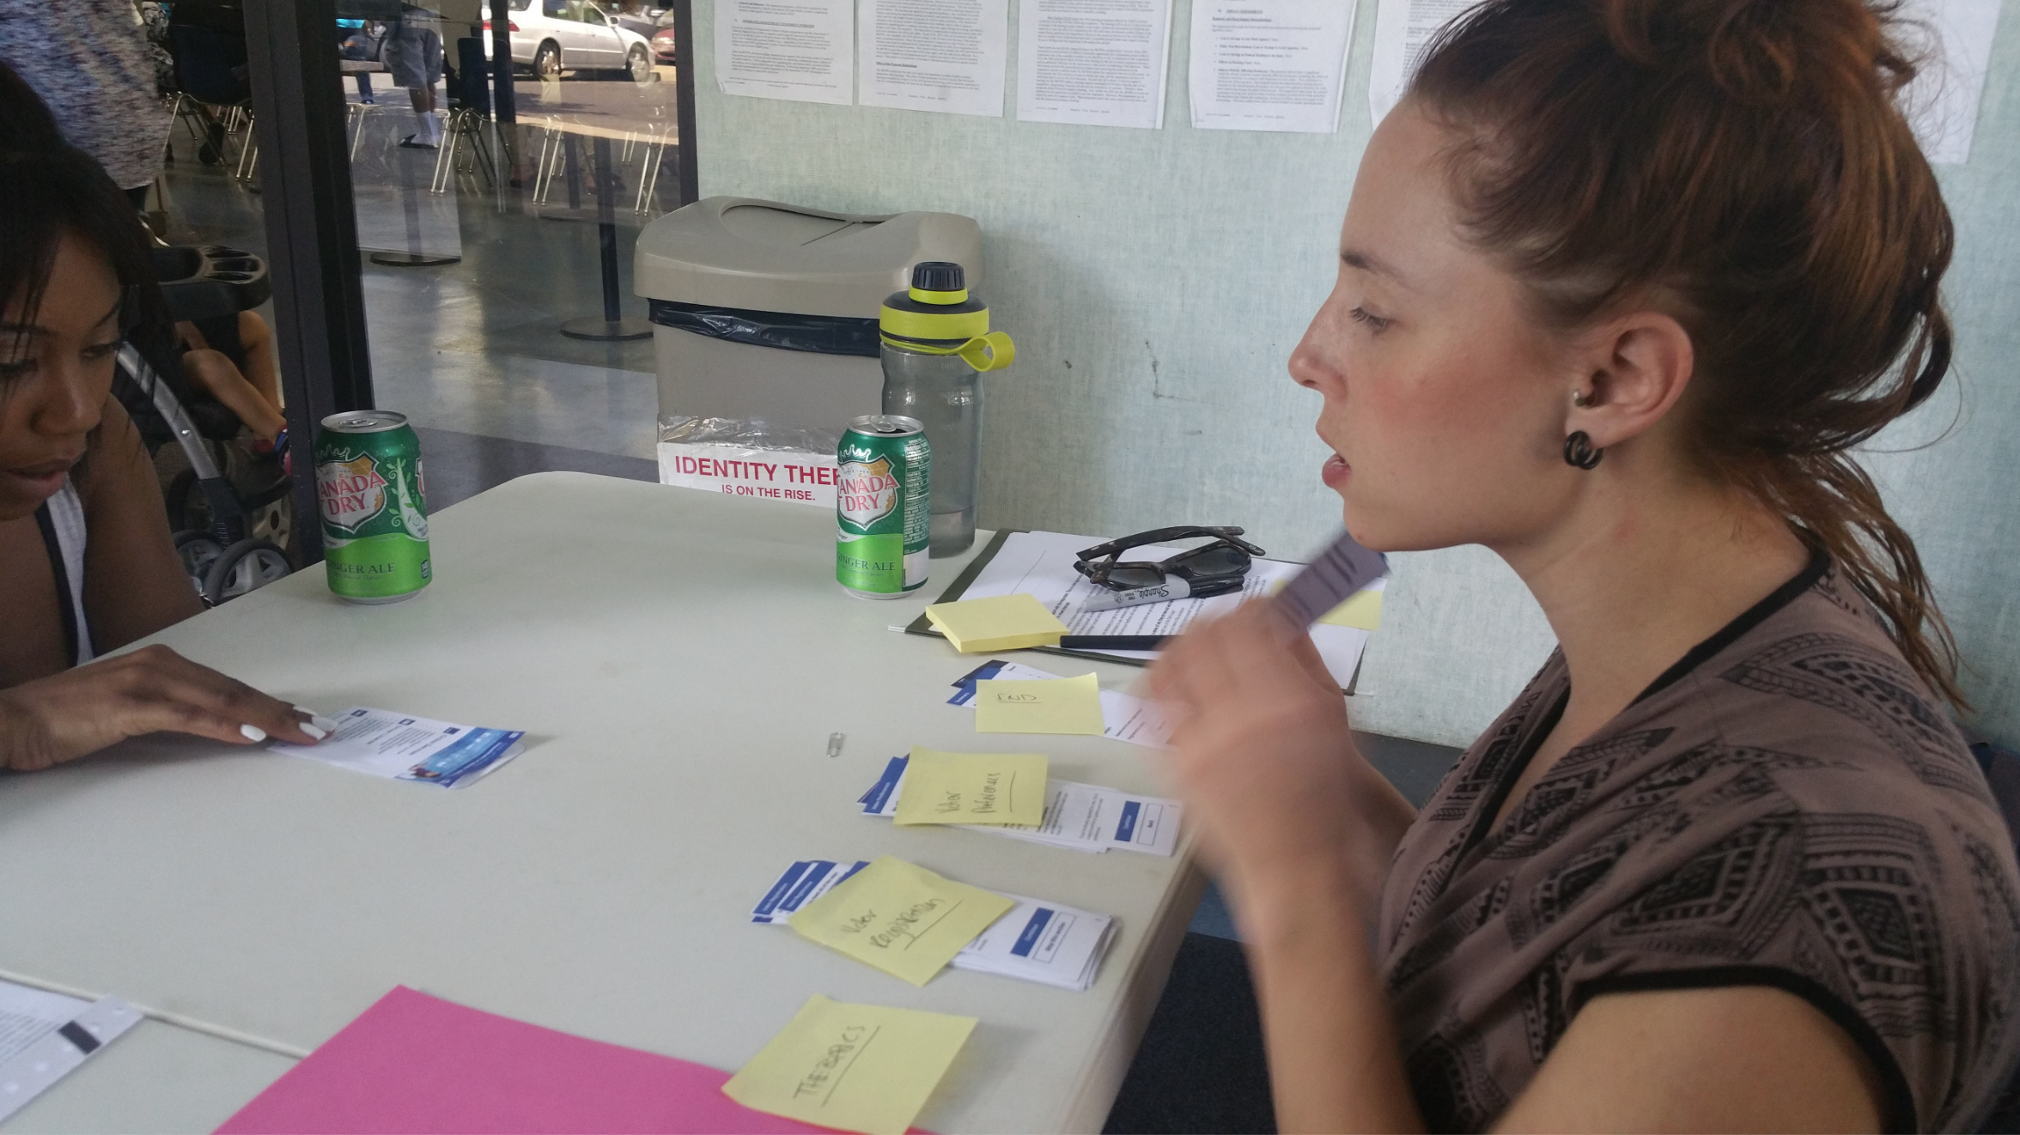
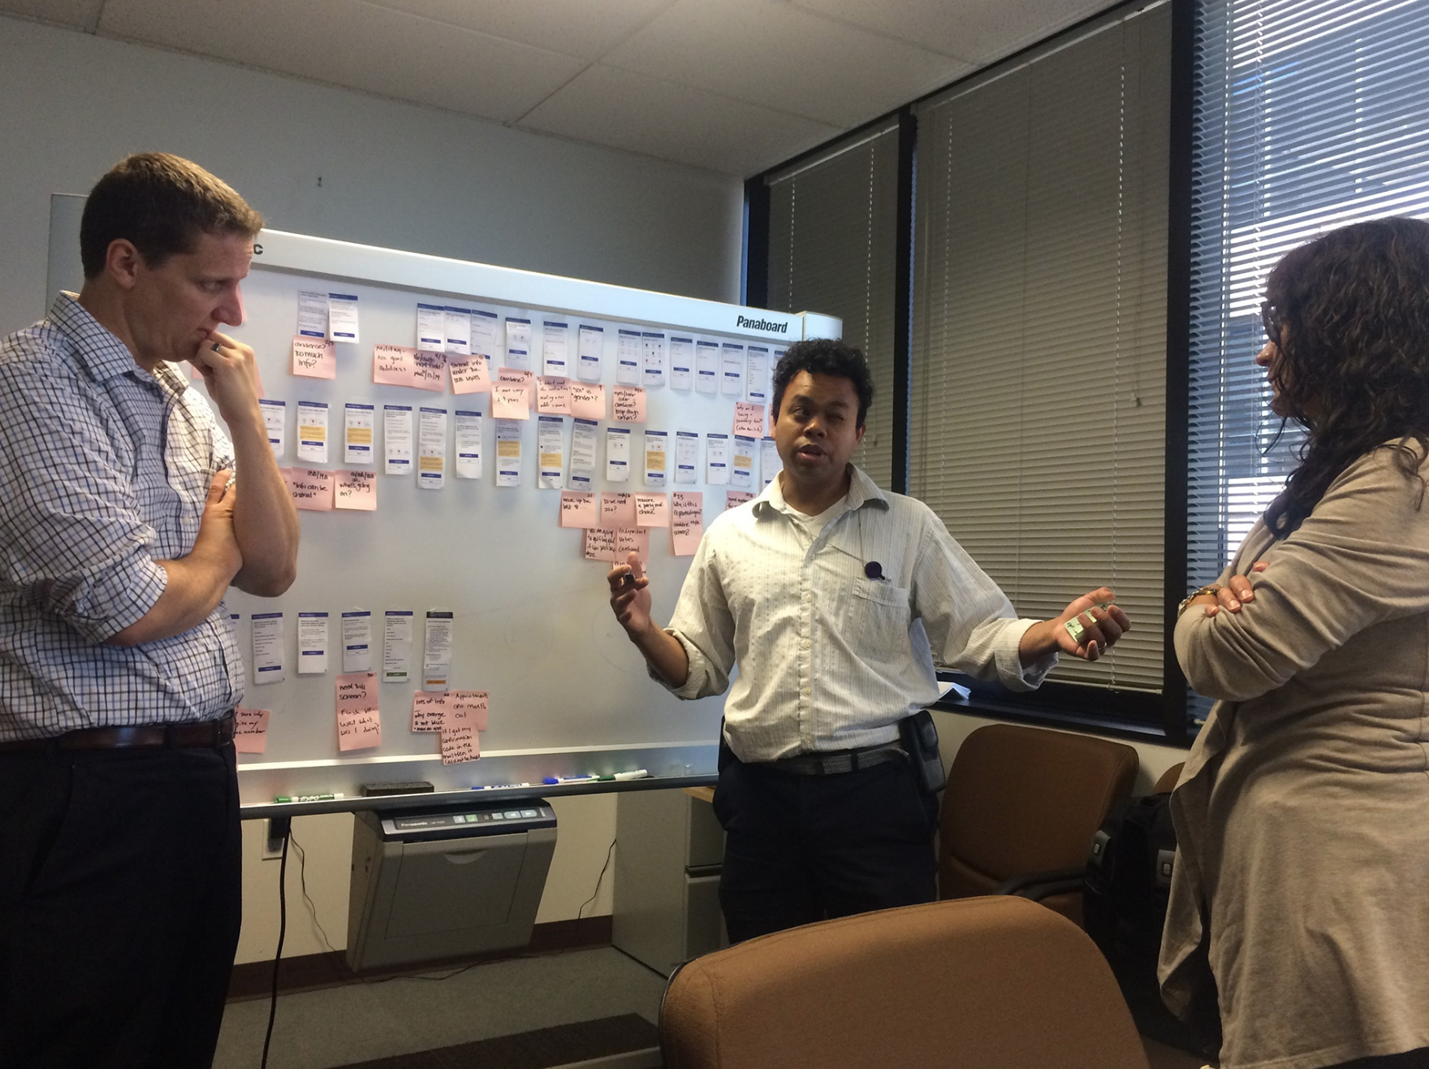
What does qualitative research look like?
Testing a Paper Prototype Concept
Participatory workshops
Notes:
End users take a slice of the information layer likely every day when they look up information and images, or complete forms online or on a mobile device.

Slide 12
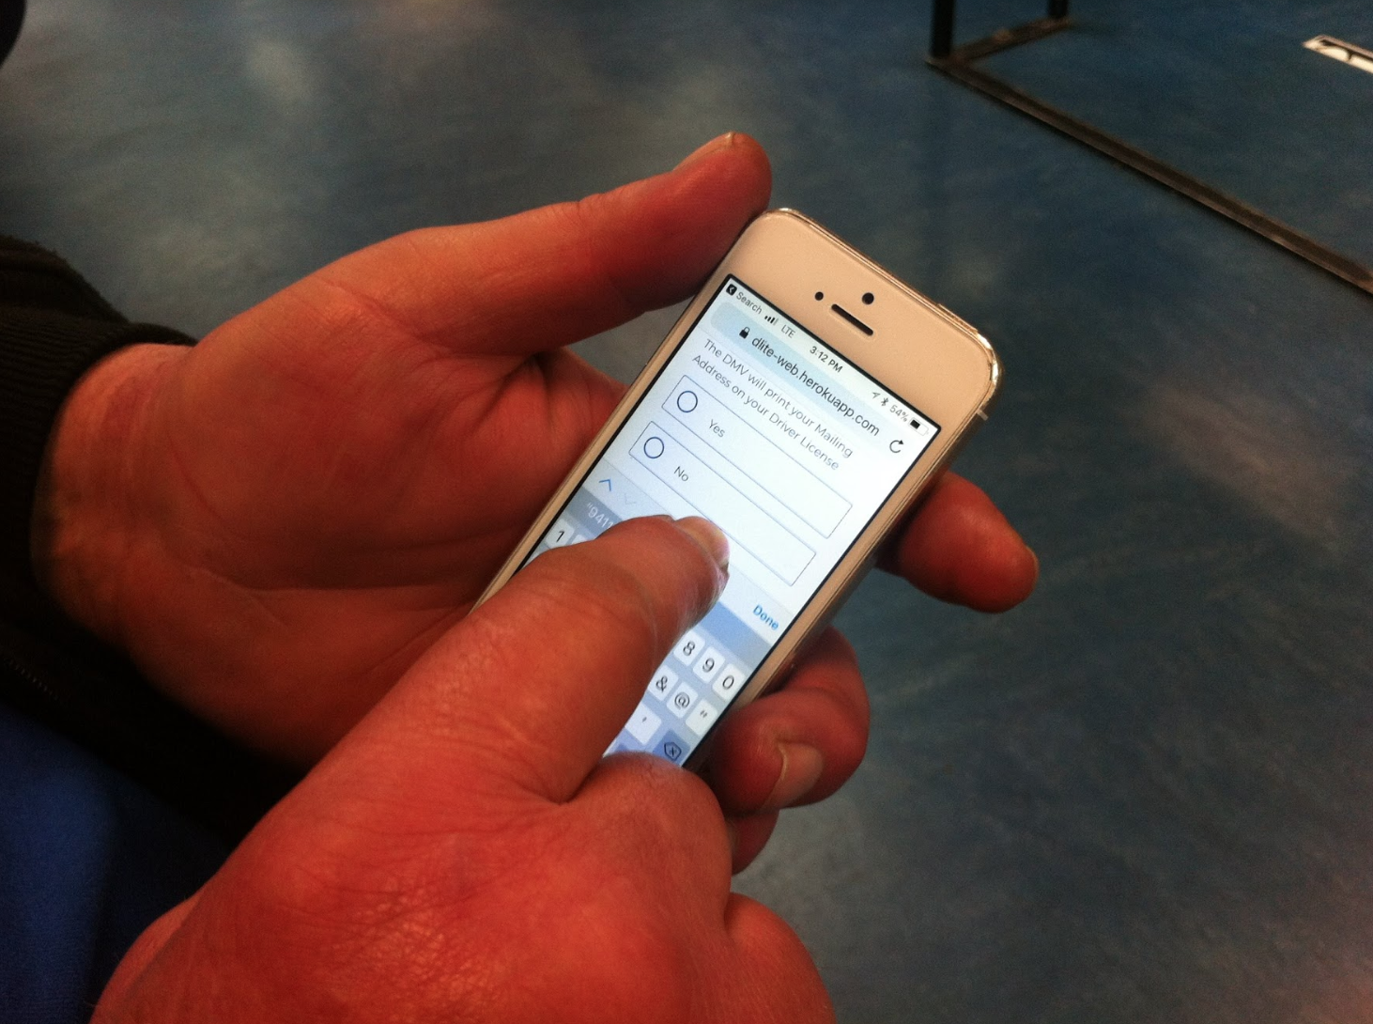
What does qualitative research look like?
Usability Testing
Notes:
End users take a slice of the information layer likely every day when they look up information and images, or complete forms online or on a mobile device.

Slide 13
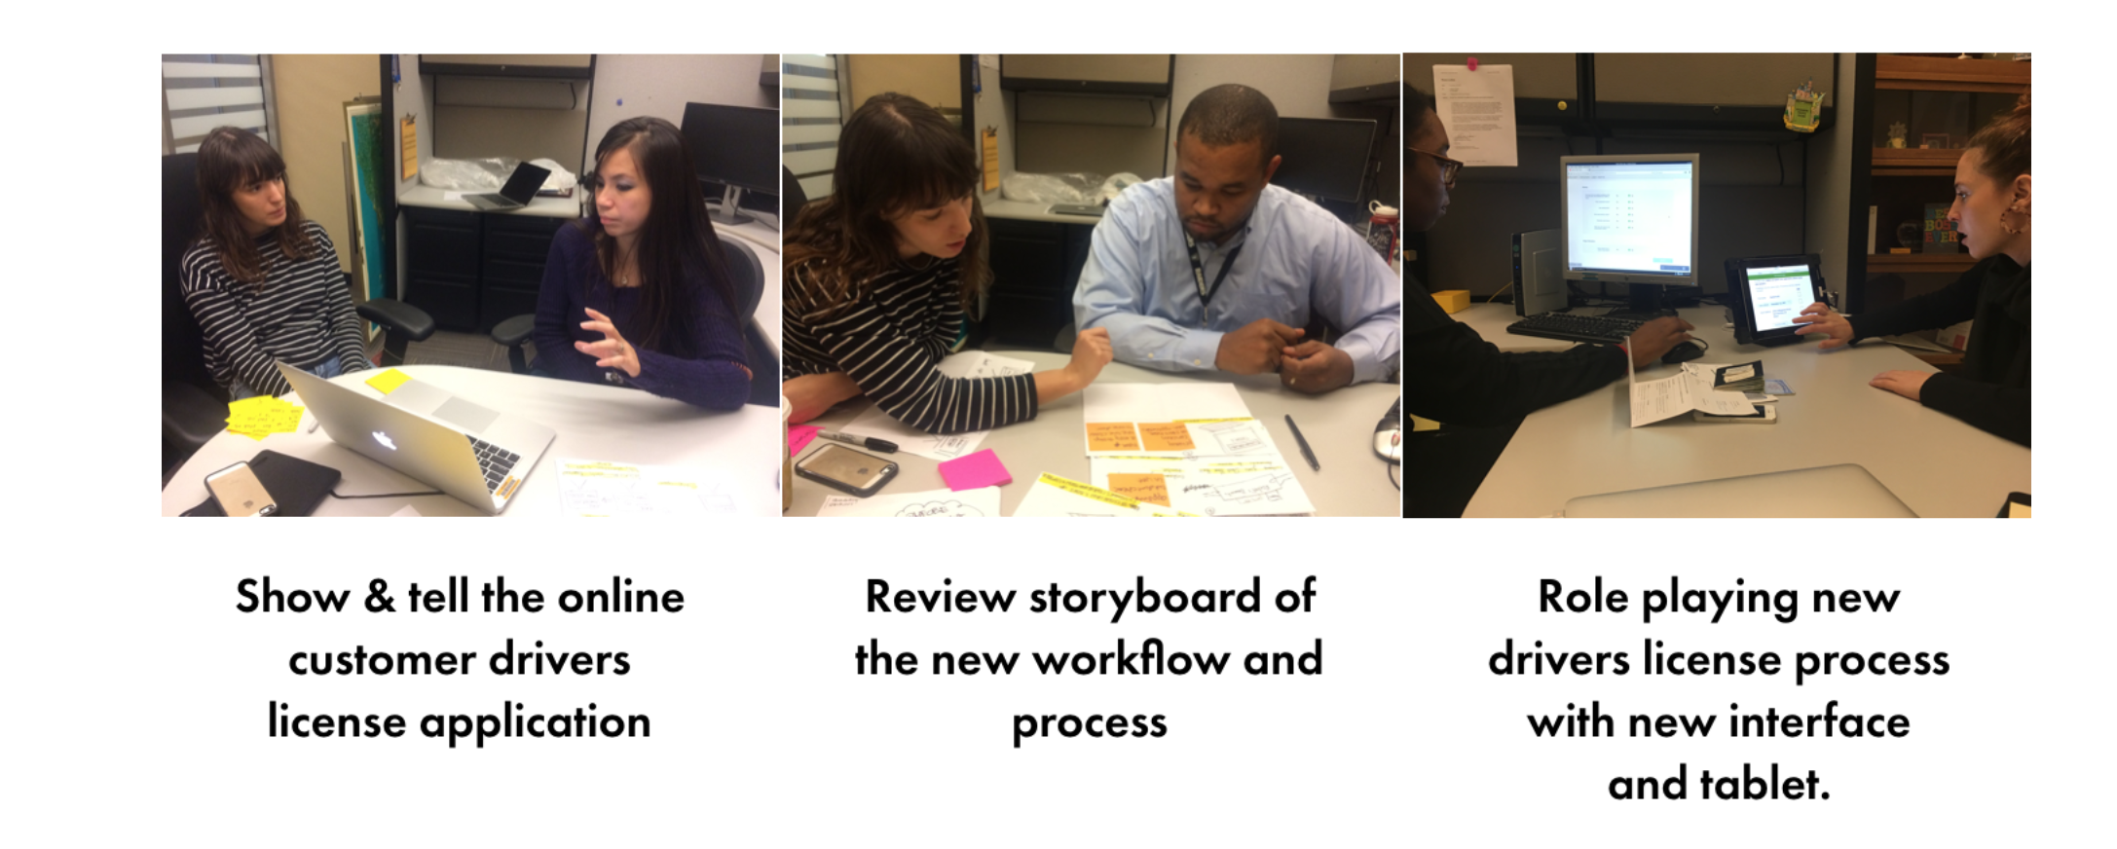
What does qualitative research look like?
Role playing a workflow and showing a storyboard concept to provoke discussion.
Notes:
End users take a slice of the information layer likely every day when they look up information and images, or complete forms online or on a mobile device.

Slide 14
Quick Knowledge Check

Slide 15
Knowledge Check - What type of research should this product owner use?
“My customers keep abandoning my website’s online shopping cart. I don’t understand why this is happening!”
- A sad product owner
Notes:
End users take a slice of the information layer likely every day when they look up information and images, or complete forms online or on a mobile device.

Slide 16
Knowledge Check - What type of research should this salesperson use?
“I believe there is an opportunity to sell a special spa & healing service to mothers who are less than 2 months postpartum.
I want to know if this is an idea that would be valuable to them.”
- A sales person
Notes:
End users take a slice of the information layer likely every day when they look up information and images, or complete forms online or on a mobile device.

Slide 17
Knowledge Check - What type of research should this entrepreneur use?
“I wonder how big the Korean community is in Orange County…. I want to know if the market is big enough to open a Korean restaurant in the area.”
- An opportunistic entrepreneur
Notes:
End users take a slice of the information layer likely every day when they look up information and images, or complete forms online or on a mobile device.

Slide 18
Important to use both Quant and Qual
Overall, both types of research are important to combine together to create a holistic understanding of a market.
Notes:
End users take a slice of the information layer likely every day when they look up information and images, or complete forms online or on a mobile device.

Slide 19
The Discovery and Design Process

Slide 20
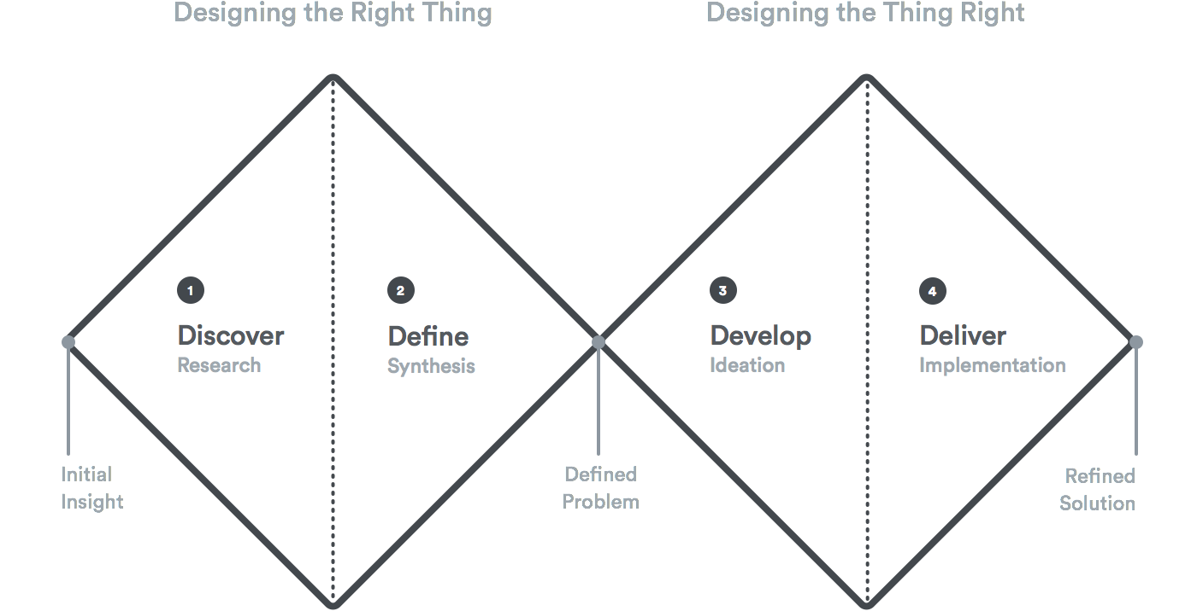
The Typical Design Process
Notes:
End users take a slice of the information layer likely every day when they look up information and images, or complete forms online or on a mobile device.

Slide 21
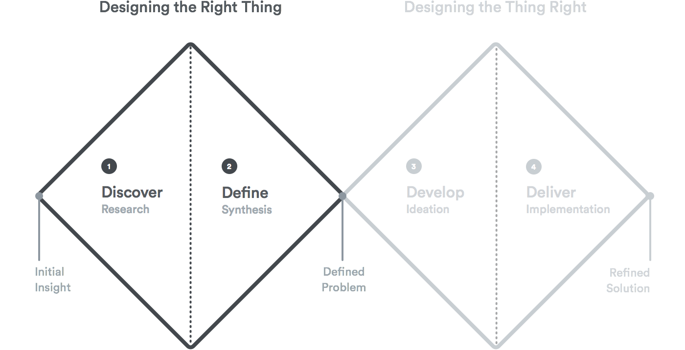
The Typical Design Process
Notes:
End users take a slice of the information layer likely every day when they look up information and images, or complete forms online or on a mobile device.

Slide 22
The Typical Design Process
Notes:
End users take a slice of the information layer likely every day when they look up information and images, or complete forms online or on a mobile device.

Slide 23
Discovery typically starts with generating this...
The Molecule Map
Person
Problem
Solution
Notes:
End users take a slice of the information layer likely every day when they look up information and images, or complete forms online or on a mobile device.

Slide 24
Discovery typically starts with generating this...
Native Koreans living in LA.
No good authentic Korean food in the Orange County area.
Person
Problem
Solution
Create an authentic Korean food restaurant in Orange County.
Notes:
End users take a slice of the information layer likely every day when they look up information and images, or complete forms online or on a mobile device.

Slide 25
Discovery typically starts with generating this...
Native Koreans living in LA.
No good authentic Korean food in the Orange County area.
Person
Problem
Solution
??????
Notes:
End users take a slice of the information layer likely every day when they look up information and images, or complete forms online or on a mobile device.

Slide 26
Discovery typically starts with generating this...
?????
No good authentic Korean food in the Orange County area.
Person
Problem
Solution
??????
Notes:
End users take a slice of the information layer likely every day when they look up information and images, or complete forms online or on a mobile device.

Slide 27
OK……….but seriously where do I start researching?
You want to start researching and gathering evidence about your
riskiest assumption….
Notes:
End users take a slice of the information layer likely every day when they look up information and images, or complete forms online or on a mobile device.

Slide 28
OK……….but seriously where do I start researching?
You want to start researching and gathering evidence on your riskiest assumption….
How do we define
“the riskiest assumption?”
Notes:
End users take a slice of the information layer likely every day when they look up information and images, or complete forms online or on a mobile device.

Slide 29

OK……….but seriously where do I start researching?
The risk that will KILL your product or business.
Notes:
End users take a slice of the information layer likely every day when they look up information and images, or complete forms online or on a mobile device.

Slide 30
Discovery typically starts with a focus on one of these atoms.
Native Koreans living in LA.
No good authentic Korean food in the Orange County area.
Person
Problem
Solution
Create an authentic Korean food restaurant in Orange County.
Notes:
End users take a slice of the information layer likely every day when they look up information and images, or complete forms online or on a mobile device.

Slide 31
Creating the Research Plan

Slide 32
The typical discovery process
Create a research plan
  Establish the space you are researching. For example, ‘Korean food in the Orange County Area’.
  The goal of the research. What information is important to learn that would prove or disprove my assumptions?
  Be inclusive and make this a collaborative process with the necessary parties.
Notes:
End users take a slice of the information layer likely every day when they look up information and images, or complete forms online or on a mobile device.

Slide 33
The typical discovery process
2. Identify the right type of research and method
Quant? Qual?
Survey?
Interview?
Prototype?
Storyboard?
Competitive analysis?
Statistical analysis?
Analytics dashboard?
Notes:
End users take a slice of the information layer likely every day when they look up information and images, or complete forms online or on a mobile device.

Slide 34
The typical discovery process
3. Identify and recruit the target audience to speak to first*
Think about where you could go to talk to your assumed target customer….
Notes:
End users take a slice of the information layer likely every day when they look up information and images, or complete forms online or on a mobile device.

Slide 35
The typical discovery process
4. Create a Discussion Guide
Introduction
Core Questions
Conclusion
Notes:
End users take a slice of the information layer likely every day when they look up information and images, or complete forms online or on a mobile device.

Slide 36
Interviewing 101 and Exercise

Slide 37
One-on-one interviews
One-on-one interviews are the most standard and commonly used practice for gaining customer insight.
They are one of the better methods for getting in-depth understanding of behavior, perceptions and behavior.
Notes:
End users take a slice of the information layer likely every day when they look up information and images, or complete forms online or on a mobile device.

Slide 38
Introductions
1. Introduce yourself and people in the room.
2. How long the interview will take.
3. State the goal is just to have a discussion about their experience with ______ .
4. No right or wrong answers to ?’s, the only right answer is their opinion.
Notes:
End users take a slice of the information layer likely every day when they look up information and images, or complete forms online or on a mobile device.

Slide 39
Introductions
5. Let him/her know nothing they say will offend you.
6. Feel free to ask questions anytime.
7. They’ll have time at the end for questions too.
8. Any questions before we begin?
Notes:
End users take a slice of the information layer likely every day when they look up information and images, or complete forms online or on a mobile device.

Slide 40
INTERVIEW DOS
Smile, but also appear neutral as best as possible
Ask Open-ended questions
  “Tell me about a time..”
  “Why?” (this is how you ladder)
  “Tell about about a specific challenge you have.”
Notes:
End users take a slice of the information layer likely every day when they look up information and images, or complete forms online or on a mobile device.

Slide 41
INTERVIEW DOS
● Get their story
“Tell me a story about when you did ‘x’ ”
“Take me through your ‘x’ process - how do you begin?”
● Be quiet and listen
● Encourage and support them throughout the interview
“This is great and helpful information”
Notes:
End users take a slice of the information layer likely every day when they look up information and images, or complete forms online or on a mobile device.

Slide 42
INTERVIEW DO’S
Talk about your product
“Let me tell you why ‘x’ tool is going to rock your world and it’s benefits”
● Talk too much
● Try to stay away from “Yes” or “No” questions
○ “Do you use ‘x’ like this or like that?”
● Ask leading questions
○ eg: DON’T: “Do you have problems with people on your team?” vs
○ DO: “What are your relationships like with the people on your team?”
Notes:
End users take a slice of the information layer likely every day when they look up information and images, or complete forms online or on a mobile device.

Slide 43
INTERVIEW DON’TS
Sell the product
○ “Interested in buying this for $4.99?”
Ask about future behavior
○ “Would you ever use ‘x’ feature?”
Point out their struggles
○ “See the button is up and to the right”, prompt the user and ask “what do you think this does?”, “How do you imagine this working?”. If there is continuous struggle kindly show them what they were looking for
Notes:
End users take a slice of the information layer likely every day when they look up information and images, or complete forms online or on a mobile device.

Slide 44
Remember...
Interviewing is an art and takes practice.
The more you practice and get feedback the better.
Notes:
End users take a slice of the information layer likely every day when they look up information and images, or complete forms online or on a mobile device.

Slide 45
Interviewing Exercise
Pick a partner
In your partnership pick who is the interviewer and interviewee.
Interview is 10 min.
Interviewer takes 5 min to write down top 5 insights on sticky notes.
Notes:
End users take a slice of the information layer likely every day when they look up information and images, or complete forms online or on a mobile device.

Slide 46
Interviewing Exercise
Interviewer make groups of 4. Interviewees join as well. Try not to join the same one as your interviewer.
Together as a group you are identifying patterns. You will create an affinity map. Categories emerge based on insights.
Notes:
End users take a slice of the information layer likely every day when they look up information and images, or complete forms online or on a mobile device.

Slide 47
Interviewing Exercise
Based on your findings do you believe you got evidence on William Sonoma’s riskiest assumption?
What emerged from the research that was unexpected?
Notes:
End users take a slice of the information layer likely every day when they look up information and images, or complete forms online or on a mobile device.

Slide 48
FIN

Slide 49
Turning Insights into Actions

Slide 50
How Might We……?
How might we…..
Provoke and reframe the insight to lead people to generate ideas.
Notes:
End users take a slice of the information layer likely every day when they look up information and images, or complete forms online or on a mobile device.

Slide 51
How Might We……?
How might we
What did you learn?
Notes:
End users take a slice of the information layer likely every day when they look up information and images, or complete forms online or on a mobile device.

Slide 52
Creating a problem statement

Slide 53
Creating a people problem statement
What a people problem actually is using an end-user, the context, the need, and the expected outcome.
For example, before Uber, a people problem was:
When pressed for time, I want to go to my next destination reliably, so that I can focus on what I have to do. But I can’t do that well because: public transport is less flexible and taxis are expensive.
Notes:
End users take a slice of the information layer likely every day when they look up information and images, or complete forms online or on a mobile device.

Slide 54
Existing people problems surface frustration, workarounds, or an inabilities to accomplish a certain goal.
However, we can’t solve every single problem — because not all problems are created equal. In reality, some affect more people, some are more profitable, and some can’t be solved at all.

Slide 55
Business Goal &
A People Problem -
A love story

Slide 56
Categorizing Business Problems
In industry business problems are usually either
Growth - we are looking for more engagement, more buyers
Airbnb had trouble growing at first- through customer insight they realized having good photos was core to the user experience.
Pivot - we are not serving the right market with our solution, we need to change to survive. Example: shopify started as a company that sold snowboards online. Wasn't getting traction, then quickly realized that building ecommerce tools was needed.
Saving costs and efficiencies
- “right now our customer support spends a lot of time answering calls from customers who claim to lose their bank card. Bank of america example.
Notes:
End users take a slice of the information layer likely every day when they look up information and images, or complete forms online or on a mobile device.

Slide 57
The strategy is the intersection between solving their people problem and achieving their business goals. Solutions that accomodate both make up the solution space.
People Problem
Before Venmo, a people problem is that “Millennials wanted to lend and borrow money from their friends, but they cannot because as cash becomes more obsolete, wire transfers and debit cards make peer-to-peer transactions tedious.”
Business Goal
However, as Venmo, a business, addresses a people problem, they needed to sustain themselves. Their business model resulted in charging businesses 2.9% for every transaction. Therefore, a business goal was to make Venmo a desirable and accessible payment medium, and to do that, they had to secure a strong and consistent user base

Slide 58
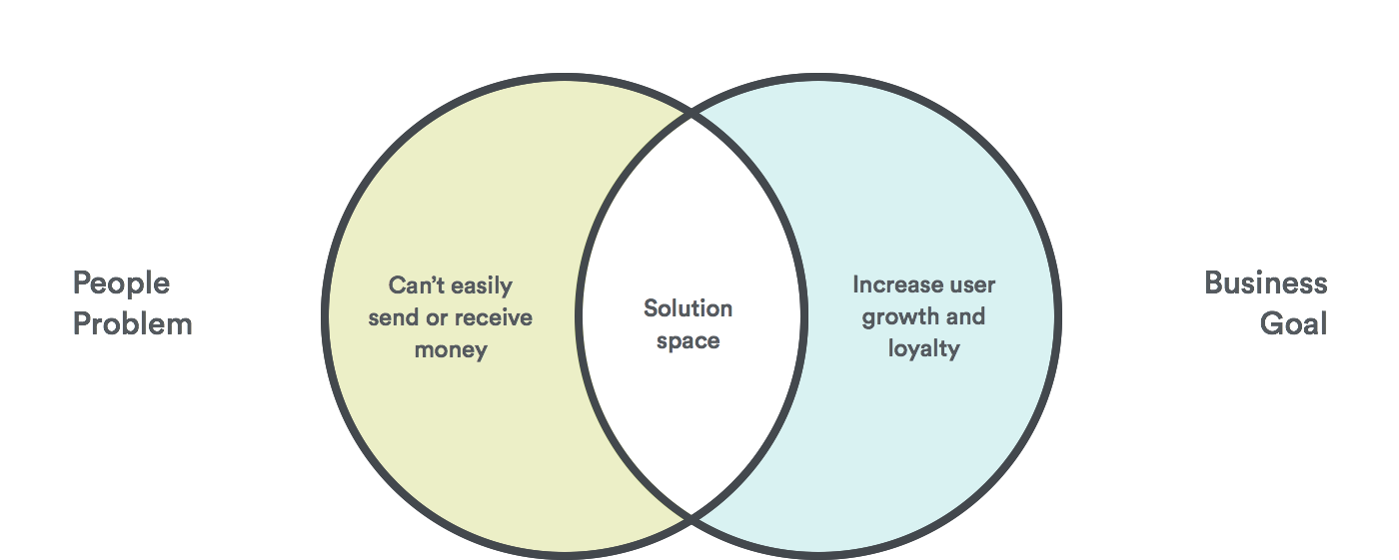
What you want to aim for….
Notes:
End users take a slice of the information layer likely every day when they look up information and images, or complete forms online or on a mobile device.

